Slide 1
Internet Archive Book Reader (IABR) Now Supports Right-to-Left Paging
Yoel Kortick
Senior Librarian

Slide 2
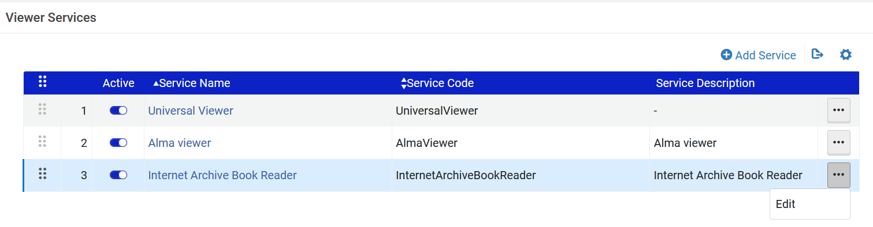
Right to left paging in the Internet Archive Book Reader (IABR)
The Internet Archive Book Reader (IABR) now supports right-to-left paging when reading books in right-to-left languages.
To support this feature, the new Paging Direction by Content Language option was added to the Service Details tab when configuring the Internet Archive Book Reader (IABR).
Access the Internet Archive Book Reader (IABR) at “Configuration > Fulfillment > Discovery Interface Display Logic > Viewer Services > Internet Archive Book Reader”.

Slide 3
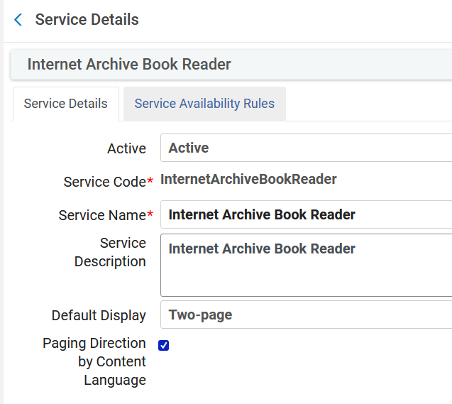
Right to left paging in the Internet Archive Book Reader (IABR)
Checking “Paging Direction by Content Language” will cause right to left paging when the bibliographic record has a right to left language.

Slide 4
Right to left paging in the Internet Archive Book Reader (IABR)
When selecting Paging Direction by Content Language, Alma checks the 008 field (position 35-37) or the dc:language field of the bibliographic record of the book.
If the language code is one of the following right-to-left languages, the book is displayed with right-to-left paging:
ara - Arabic
arc - Official Aramaic (700-300 BCE); Imperial Aramaic (700-300 BCE)
aze - Azerbaijani
div - Divehi; Dhivehi; Maldivian
per - Persian
fas - Persian
hau - Hausa
heb - Hebrew
kas - Kashmiri
khw - Khowar
kur - Kurdish
pus - Pushto; Pashto
sam - Samaritan Aramaic
syc - Classical Syriac
syr - Syriac
urd - Urdu
yid - Yiddish

Slide 5
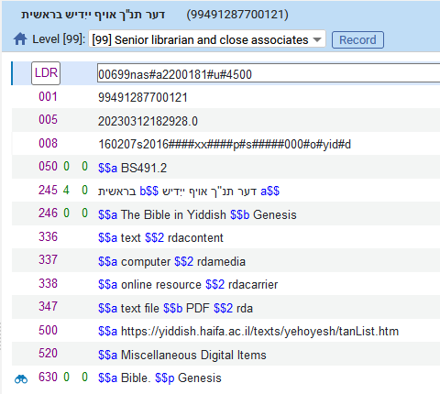
Right to left paging in the Internet Archive Book Reader (IABR)
For example this record (דער תנ"ך אויף ייִדיש) (Varying form of title “The Bible in Yiddish”) is in language “Yiddish” which is one of the listed right to left languages
008 pos. 35-37 = yid

Slide 6
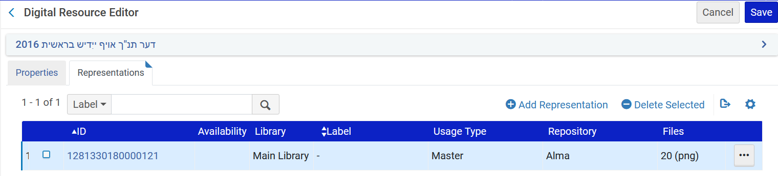
Right to left paging in the Internet Archive Book Reader (IABR)
This record has a digital representation with png files which may be viewed in the Internet Archive Book Reader (IABR)

Slide 7
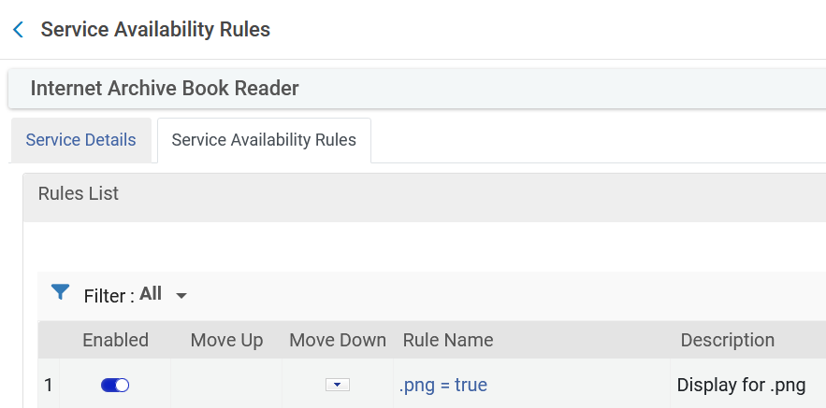
Right to left paging in the Internet Archive Book Reader (IABR)
As a “side comment”: the png files can be viewed in the Internet Archive Book Reader (IABR) because of the rule in the “Service Availability Rules”.

Slide 8
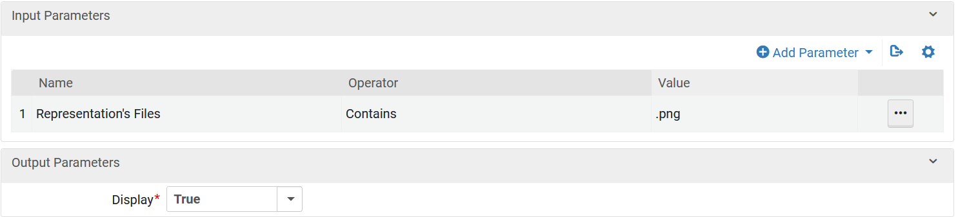
Right to left paging in the Internet Archive Book Reader (IABR)
Here are the parameters of the rule

Slide 9
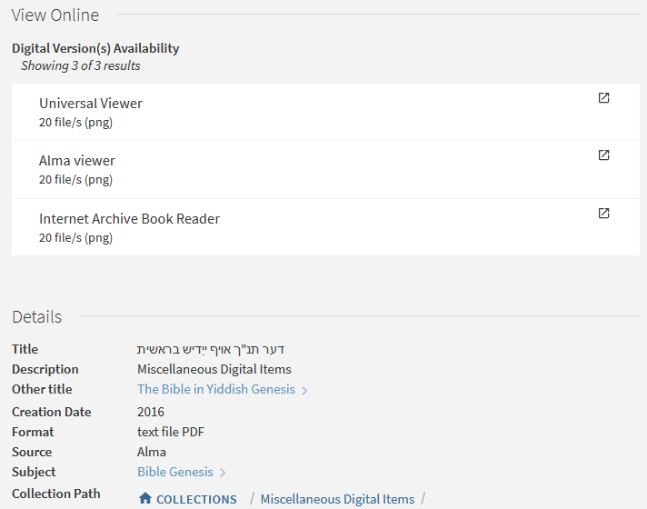
Right to left paging in the Internet Archive Book Reader (IABR)
The end user in Primo selects “Internet Archive Book Reader”.

Slide 10
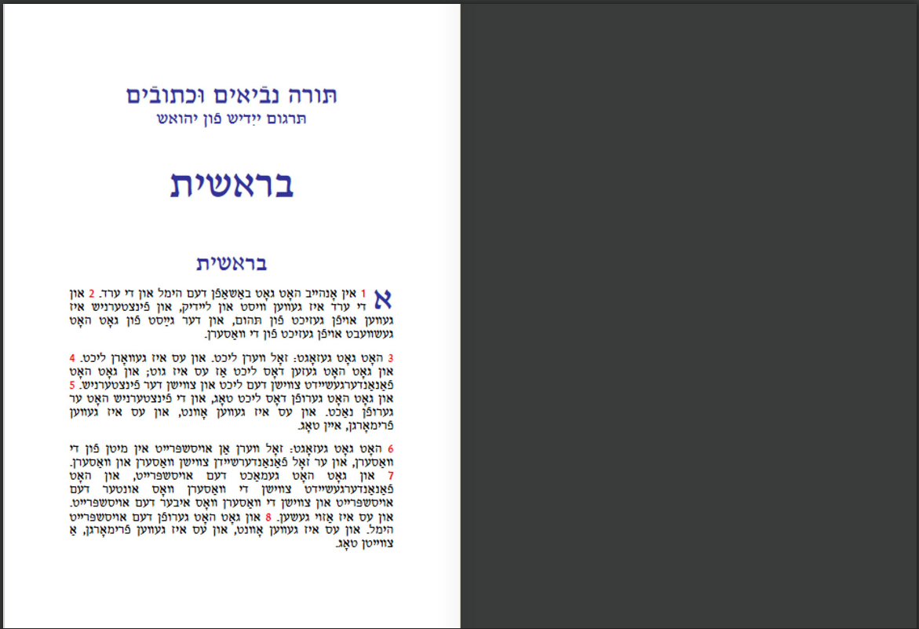
Right to left paging in the Internet Archive Book Reader (IABR)
This is page 1. When it is clicked, it will open to the right, and we will see page 2 on the right and page 3 on the left.

Slide 11
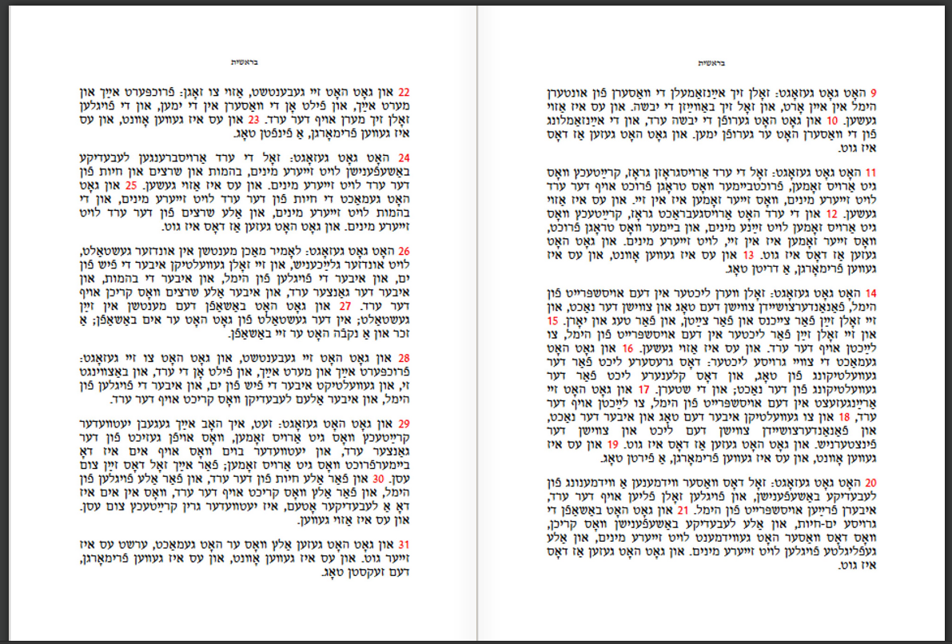
Right to left paging in the Internet Archive Book Reader (IABR)
This is pages 2 and 3
Page 3
Page 2
When we click again this page will open to the right

Slide 12
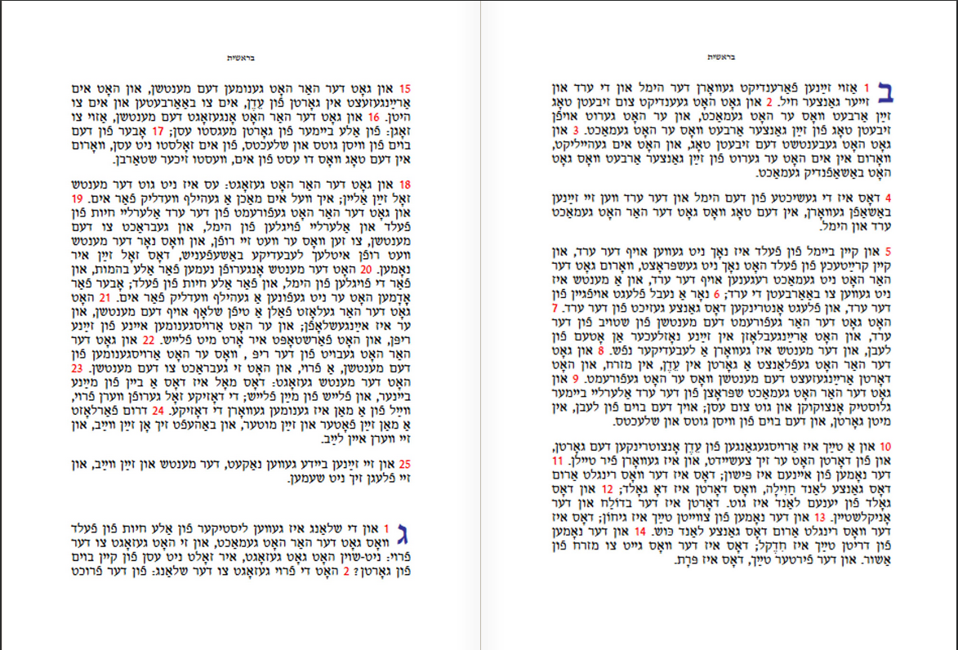
Right to left paging in the Internet Archive Book Reader (IABR)
This is pages 4 and 5
Page 4
Page 5

